Slide 1
Hotel Booking Demand
Norman Cattles

Slide 2
Dataset Choice
Hotel Booking Demand
This dataset comprises detailed records of over 100,00 hotel bookings, including various details such as hotel type, hotel country, booking date, arrival date, length of stay, and much more
very diverse in terms of the information it provides, offering opportunities to analyze booking patterns and customer preferences
addresses current trends in travel, providing valuable insights for decision-making

Slide 3
Data Preprocessing

Slide 4
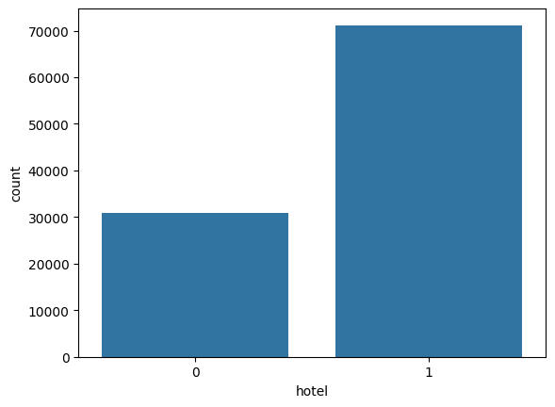
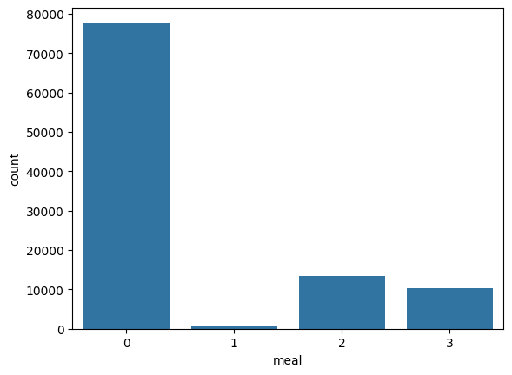
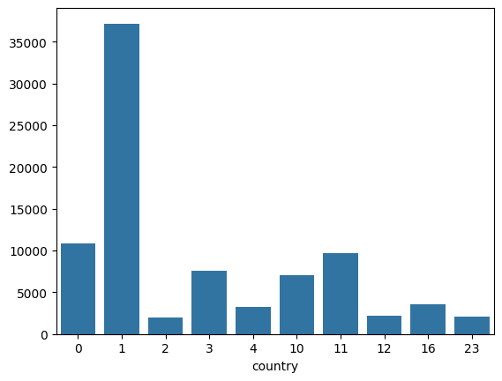
Results and Insights
Most hotel bookings were for a city hotel (~70,000) as opposed to a resort hotel (~30,000)
Overwhelming majority of meal types were for bed and breakfast (~75,000)
Top 10 Booking Countries:
(GBR, 0)(PRT, 1)(USA, 2)(ESP, 3)(IRL, 4)(DEU, 10)
(FRA, 11)(BEL, 12)(ITA, 16)(BRA, 23)

Slide 5
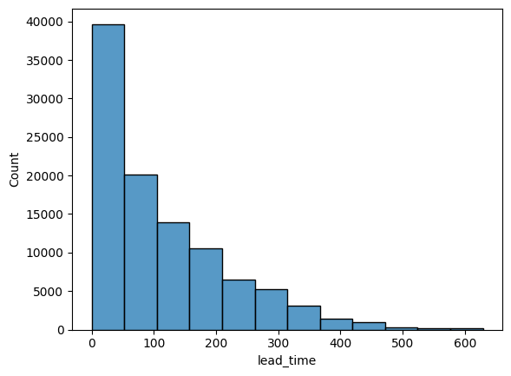
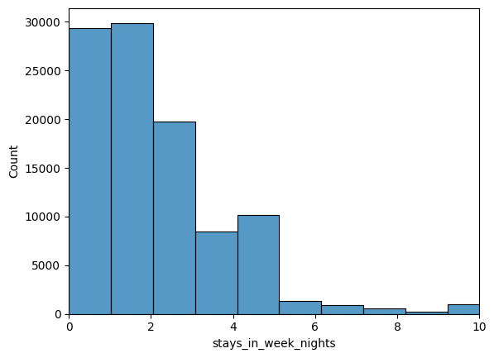
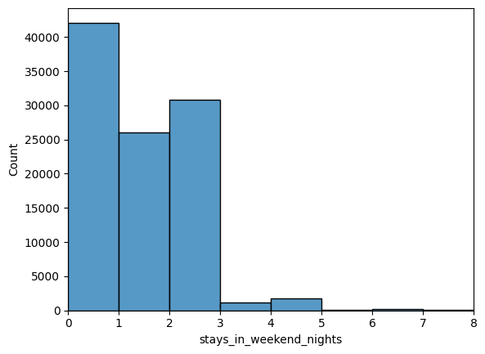
Results and Insights
Most people book their hotels within 3 months of their reservation (~60,000)
Most people stay for 0-3 nights during the week (~80,000)
0-2 nights during the weekend (~70,000)

Slide 6
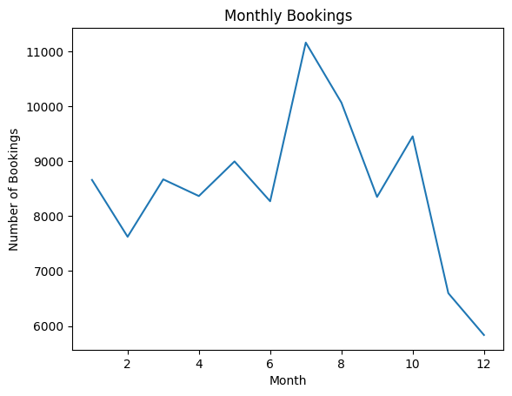
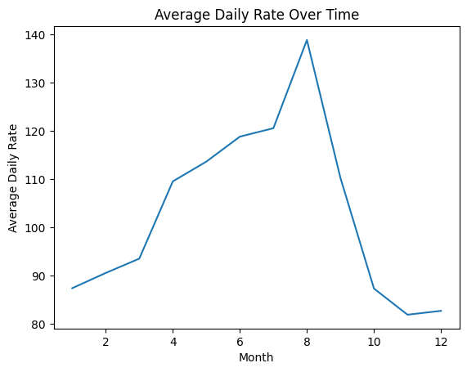
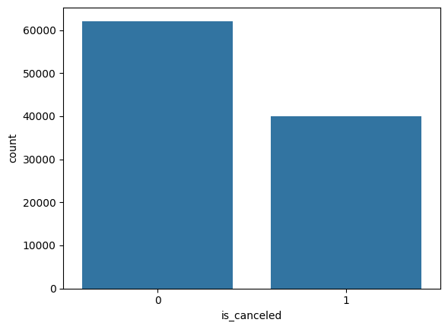
Results and Insights
Most reservations were made for the summer / least reservations were made for the winter
ADR: average revenue earned per available room per day
Total daily revenue / # of rooms sold in a day
Over 35,000 reservations were cancelled

Slide 7
Challenges/Conclusion
Challenges
Lack of origin information
One significant challenge is the absence of data regarding customers' booking origins and purposes, which limits our ability to fully understand booking motivations and regional booking trends
Conclusion
These results can be utilized effectively in many different ways:
Operational efficiency
Data analysis such as this can help hotels better manage staff and rooms, making operations smoother during busy times
Marketing insights
Understanding guest preferences guides targeted marketing efforts and strategic planning, which can boost guest satisfaction and enhance business growth

Slide 8
Questions?

